Slide 1
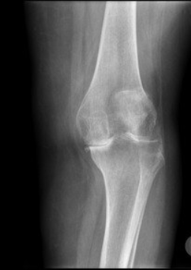
X-Ray Vision Smarter Decision

Slide 2
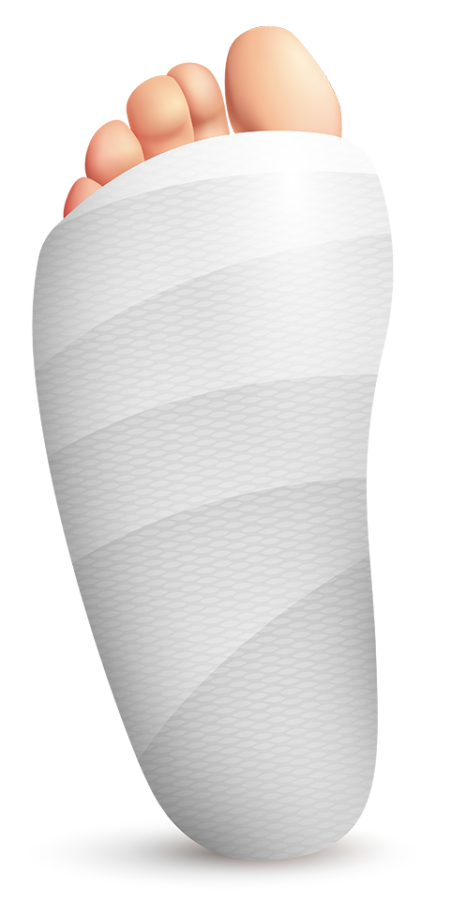
TABLE OF CONTENTS
01
01
02
02
03
03
04
04
05
05
06
06
OVERVIEW
ARCTICTURE of SYSTEM
ARCTICTURE of NOTEBOOK
MODELS
OUR APP
OUR TEAM

Slide 3
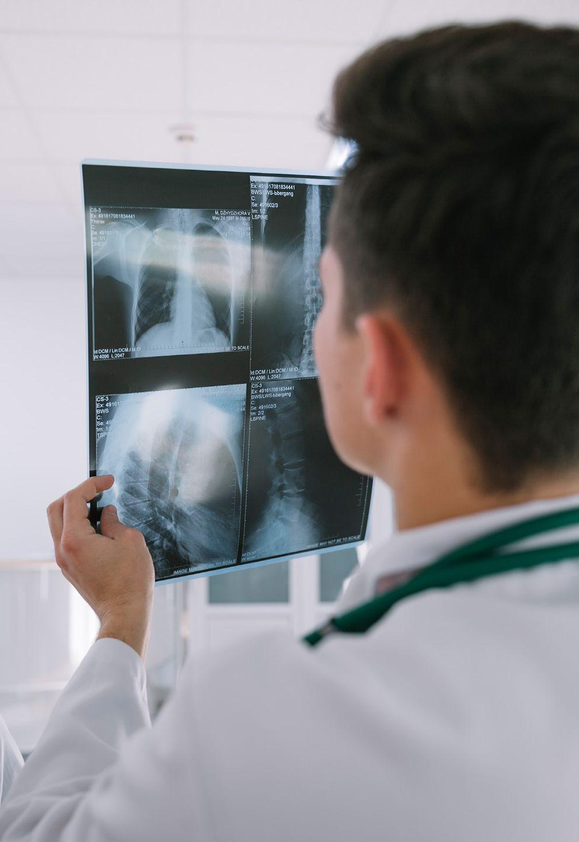
01
OVERVIEW

Slide 4
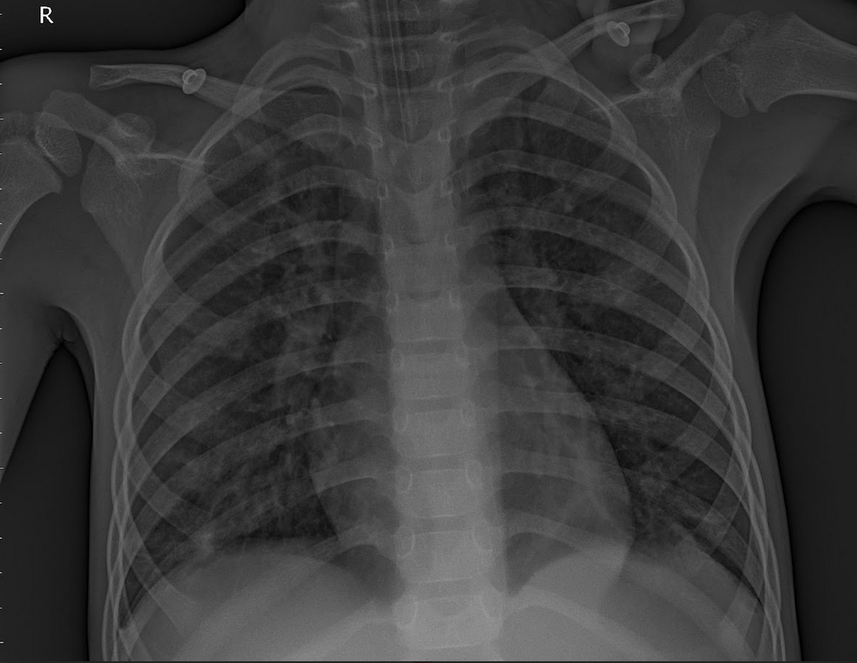
01
The Smart X-Ray System revolutionizes medical diagnostics by leveraging Artificial Intelligence (AI) to analyze X-ray images and generate detailed diagnostic reports. This cutting-edge solution addresses challenges in radiology, such as:
Reducing workloads for healthcare professionals.
Ensuring high diagnostic accuracy.
Expanding access to quality diagnostics in underserved regions.
By integrating advanced image analysis through machine learning with professional report generation using a large language model (LLM), the system enhances healthcare outcomes and streamlines medical workflows.

Slide 5
02
ARCTICTURE of SYSTEM

Slide 6
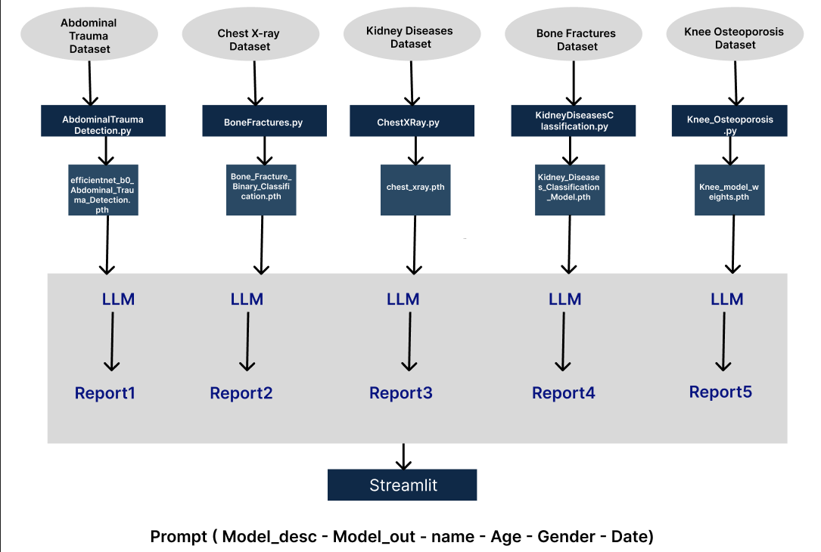
02

Slide 7
03
ARCTICTURE of NOTEBOOK

Slide 8
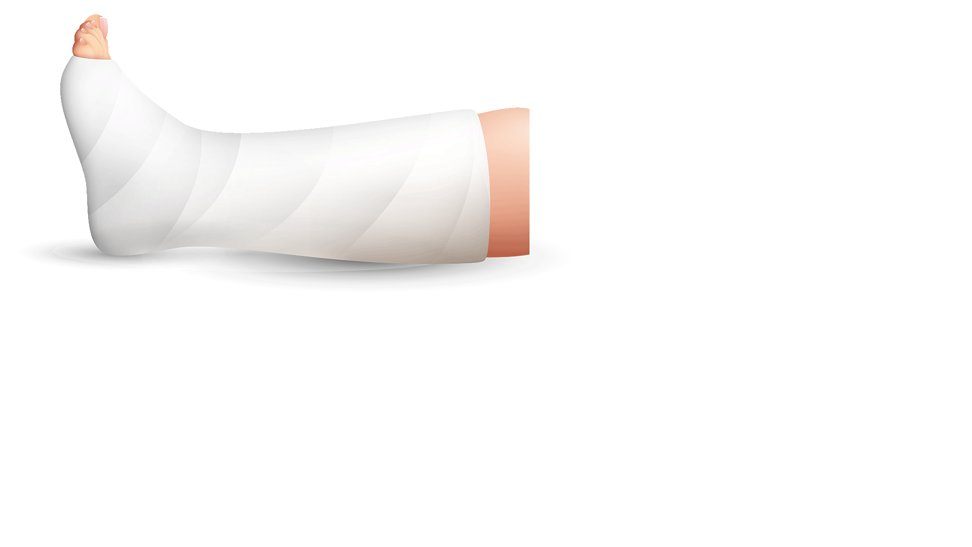
Getting the Dataset
Visualize the Dataset
Data Analysis
Data Transformation
Data Splitting
Prepare Dataloaders
Build Model Architecture
Show Model Summary
Define Optimizer and Loss Function
Training Loop
Evaluate on Test Data
Use Evaluation Metrics
Make Predictions and Visualize
Save the Model
Linking with LLM

Slide 9
04
MODELS

Slide 10
04
Abdominal Trauma
Chest X-ray
Kidney Diseases
Bone Fractures
Knee Osteoporosis

Slide 11
1- Abdominal Trauma
04
Overview
Traumatic injuries cause over 5 million deaths annually, with accurate diagnosis of abdominal injuries crucial for improving survival.
Develop an automated system to detect injuries in CT scans, helping medical professionals make timely decisions.
Objective
Binary Multi-Label Classification
Labels include:
Bowel, Extravasation, Kidney, Liver, and Spleen Injuries (Healthy/Injury, Low/High)
Any Injury (Presence/Absence)
Problem Type

Slide 12
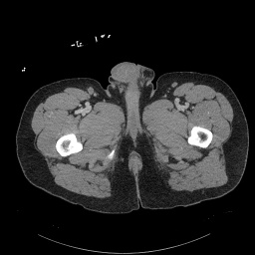
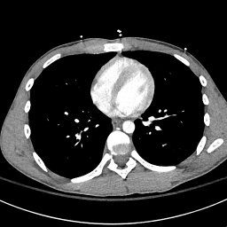
90.21%
93.68%
85.70%
Accuracy
Recall
Precision

Slide 13
2- Chest X-ray
04
Chest diseases affect millions globally, and this project uses CNNs to automate the diagnosis of conditions (normal, bacterial pneumonia, viral pneumonia) from X-ray images, improving accuracy and care efficiency.
Overview
Objective
To develop an automated system that classifies chest conditions from X-ray images, enhancing diagnostic reliability and aiding healthcare professionals in delivering faster care.
Problem Type
Multi-class classification (Normal, Pneumonia Bacteria, Pneumonia Virus)

Slide 14
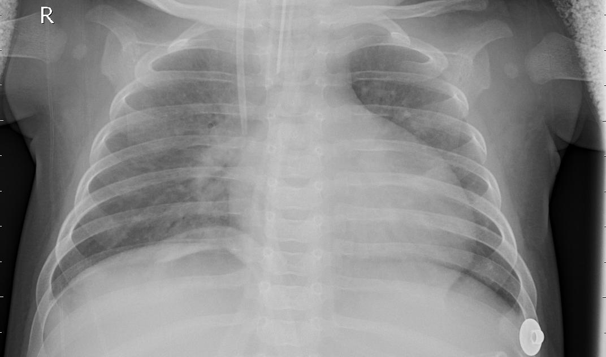
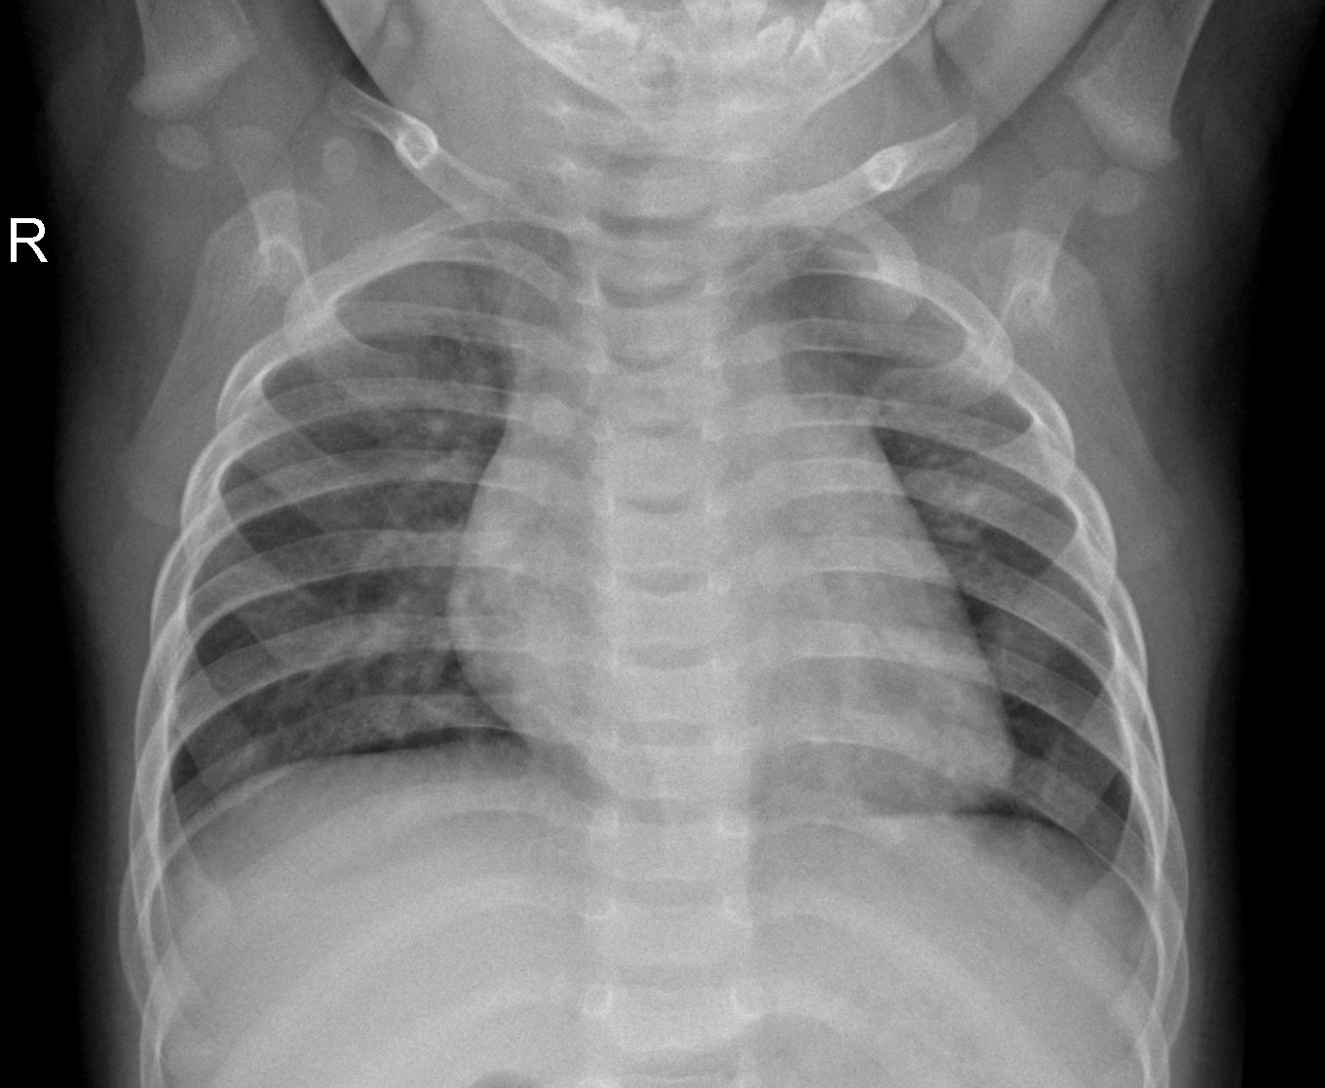
95.12%
95.26%
95.21%
Accuracy
Recall
Precision

Slide 15
3- Kidney Diseases
04
Overview
Kidney diseases, including cysts, tumors, and stones, can significantly affect health if not diagnosed early. This project uses CNNs to automate the detection and classification of kidney diseases from CT scans, improving diagnostic accuracy and decision-making.
Objective
To develop an automated system for detecting and classifying kidney diseases, enhancing diagnostic precision and reducing healthcare professionals' workload.
Problem Type
Multi-class classification (Cyst, Stone, Tumor, Normal)

Slide 16
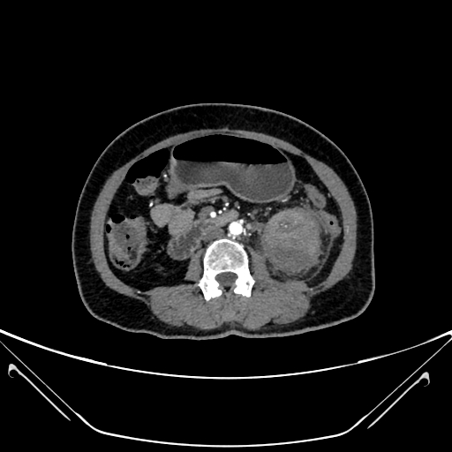
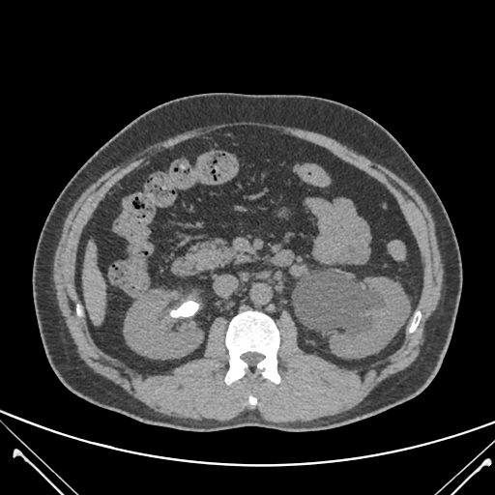
100%
100%
100%
Accuracy
Recall
Precision

Slide 17
4- Bone Fractures
04
Overview
This project uses CNNs to automate the detection and classification of bone fractures from X-ray images across various body regions, improving diagnostic accuracy and decision-making.
To develop an automated system for detecting and classifying bone fractures, enhancing diagnostic precision and reducing healthcare professionals' workload.
Objective
Problem Type
Binary classification (Fractured, Non-fractured)

Slide 18
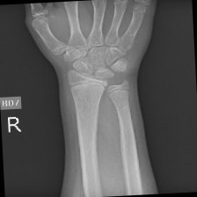
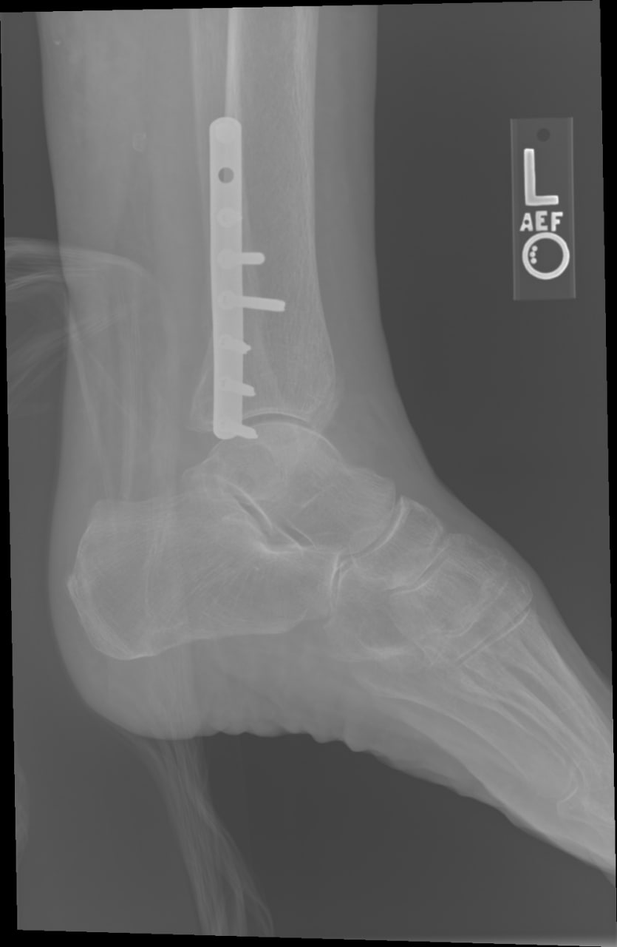
99.21%
96.16%
99.26%
Accuracy
Recall
Precision

Slide 19
5- Knee Osteoporosis
04
Overview
Knee osteoporosis is a condition of decreased bone density, increasing fracture risk and reducing mobility. This project uses CNNs to automate the detection and classification of knee osteoporosis stages from X-ray images, improving diagnostic accuracy and decision-making.
To develop an automated system for detecting and classifying knee osteoporosis stages, enhancing diagnostic precision and supporting efficient healthcare delivery.
Objective
Problem Type
Multi-class classification (Normal, Osteopenia, Osteoporosis)

Slide 20
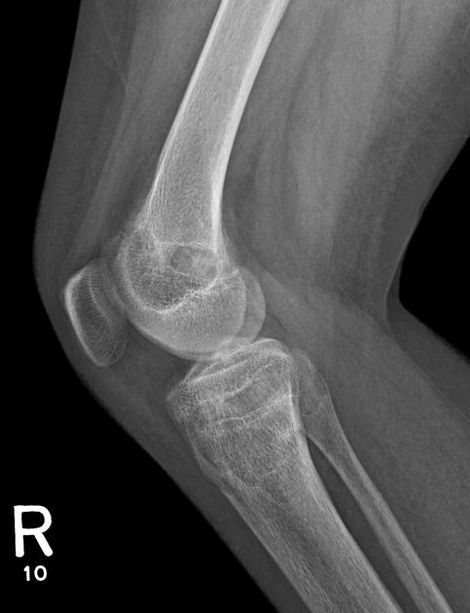
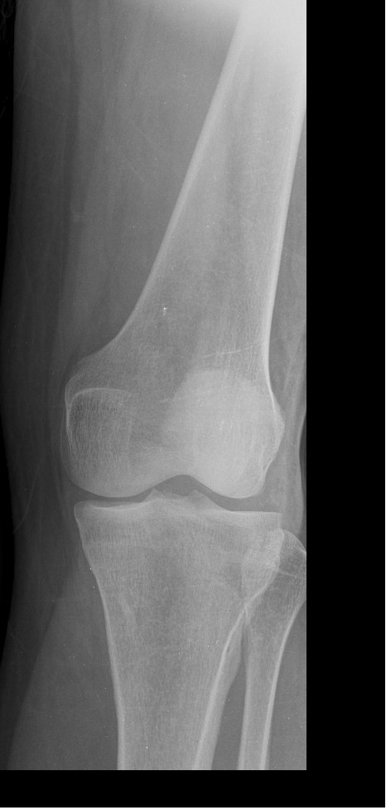
83.28%
83.28%
83.81%
Accuracy
Recall
Precision

Slide 21
05
OUR APP

Slide 22
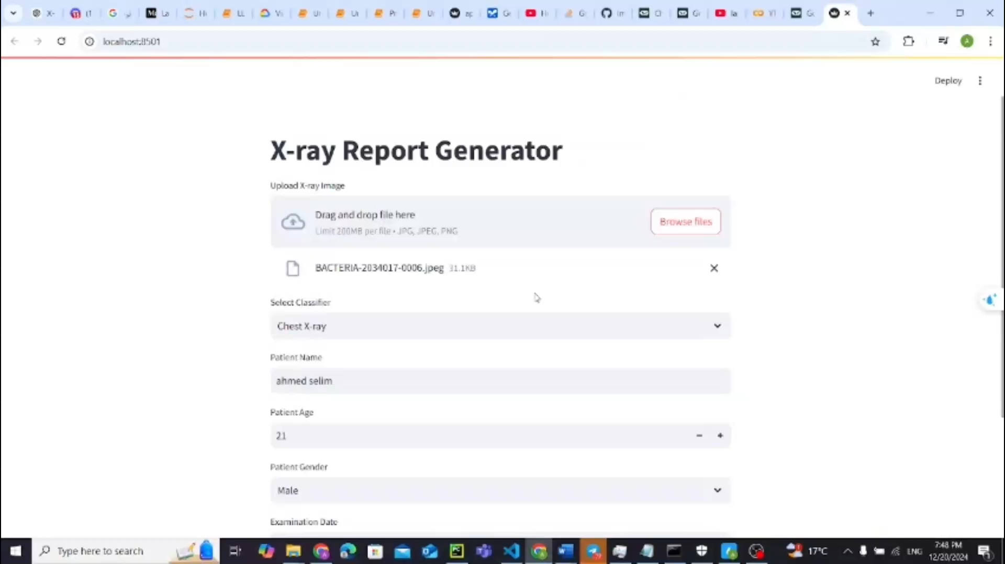
05

Slide 23
06
OUR TEAM

Slide 24
06
Ahmed Selim Mohmoud
Sohila Ayman Lashien
Abdelrahman Elsayed Mohammed
Hager Mohammed Hegazy
Nour Ali Abdelmordi Saif
Mennat-Allah Yousri Rabeh
Mennat-Allah Medhat Mostafa

Slide 25
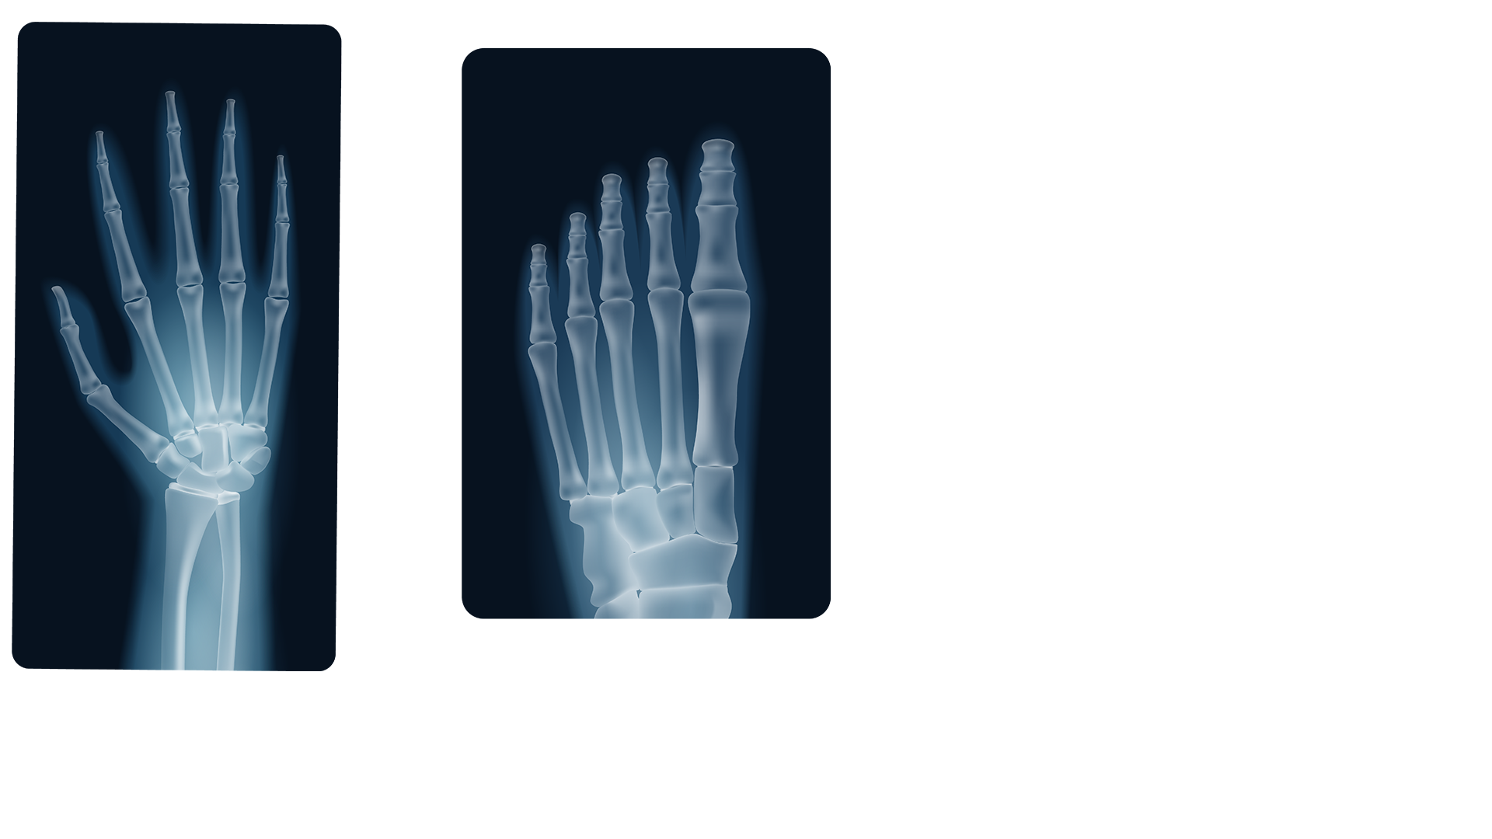
THANKS

